Slide 1
What is Computer Vision?
Anupam Guha

Slide 2
What is computer vision?
What are we doing when we see?
Data in images
Geometry
Image processing
Understanding images

Slide 3
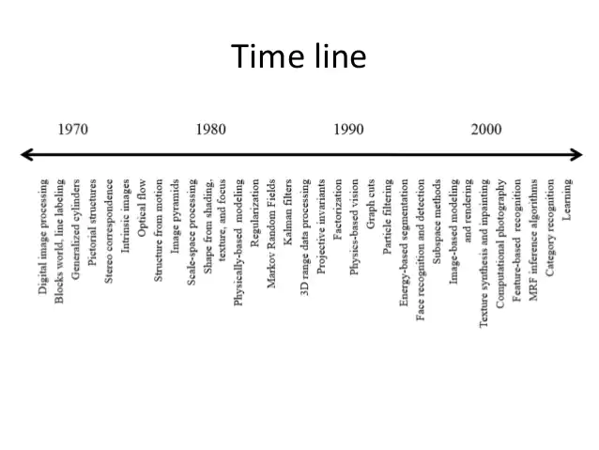

Slide 4
Standard tasks
Image processing
Feature extraction
Segmentation
Stitching
Recognition
Detection
Captioning

Slide 5

Edge detection

Slide 6
Mathematics involved
Calculus
Linear algebra
Signal processing
Geometry
Optimisation theory

Slide 7
Resources
Python
Google colab
OpenCV
MATLAB/R
Gimp

Slide 8
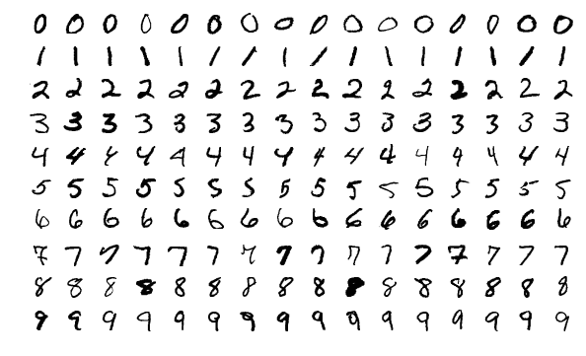
Simple Example
MNIST dataset

Slide 9
MNIST in its simplest
import matplotlib.pyplot as plt
from sklearn import datasets, svm, metrics
from sklearn.model_selection import train_test_split
digits = datasets.load_digits()
n_samples = len(digits.images)
data = digits.images.reshape((n_samples, -1))
target = digits.target
clf = svm.SVC(gamma=0.001)
X_train, X_test, y_train, y_test = train_test_split(data, target, test_size=0.5, shuffle=False)
clf.fit(X_train, y_train)
predicted = clf.predict(X_test)
disp = metrics.ConfusionMatrixDisplay.from_predictions(y_test, predicted)
disp.figure_.suptitle("Confusion Matrix")
plt.show()

Slide 10
Imagenet
https://www.image-net.org/
14,197,122 images, 21841 synsets indexed
1000 images to illustrate each synset
Quality controlled
Human annotated

Slide 11

So what is deep learning again?

Slide 12
What is a convolution layer?

Slide 13
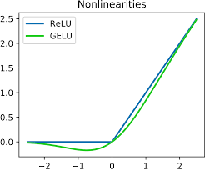
What is a RELU (Rectified Linear Unit ) layer?

Slide 14
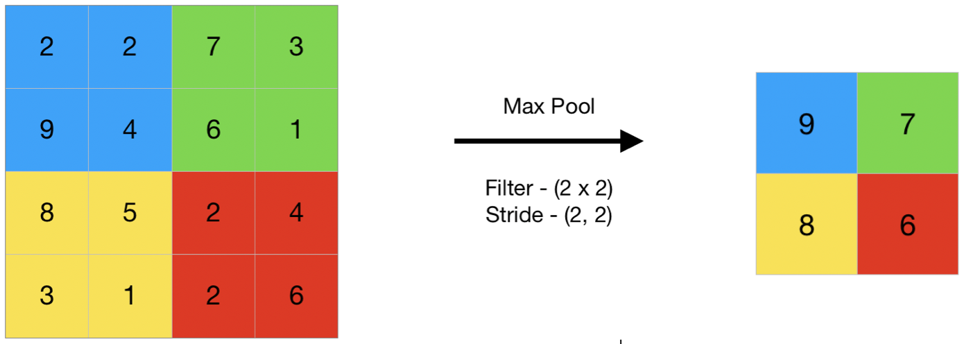
What is a pooling layer?

Slide 15

A Simple Use Case

Slide 16
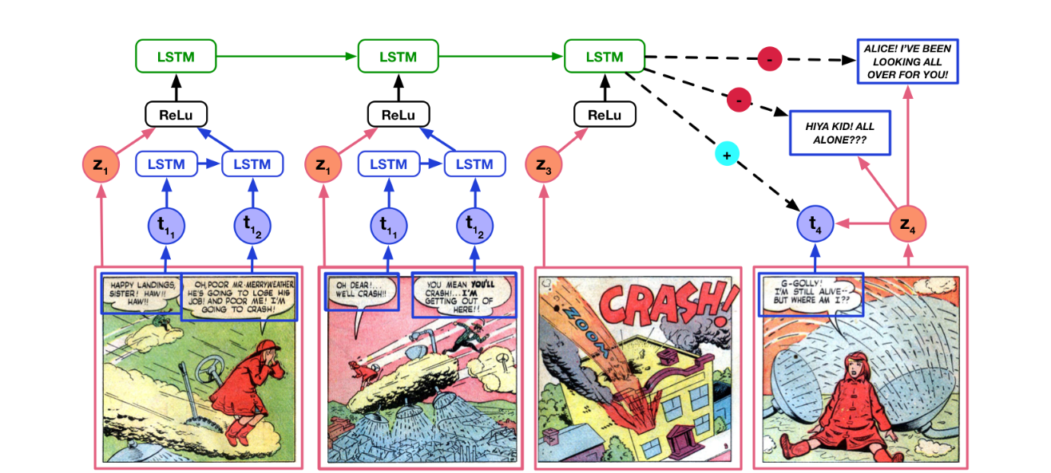
A Complex Use Case

Slide 17
MNIST Code using Keras
from numpy import mean
from numpy import std
from matplotlib import pyplot
from sklearn.model_selection import KFold
from keras.datasets import mnist
from keras.utils import to_categorical
from keras.models import Sequential
from keras.layers import Conv2D
from keras.layers import MaxPooling2D
from keras.layers import Dense
from keras.layers import Flatten
from keras.optimizers import SGD

Slide 18
Code – function to load data
def load_dataset():
# load dataset
(trainX, trainY), (testX, testY) = mnist.load_data()
# reshape dataset to have a single channel
trainX = trainX.reshape((trainX.shape[0], 28, 28, 1))
testX = testX.reshape((testX.shape[0], 28, 28, 1))
# one hot encode target values
trainY = to_categorical(trainY)
testY = to_categorical(testY)
return trainX, trainY, testX, testY

Slide 19
Code - Train and Test Dataset
def prep_pixels(train, test):
# convert from integers to floats
train_norm = train.astype('float32')
test_norm = test.astype('float32')
# normalize to range 0-1
train_norm = train_norm / 255.0
test_norm = test_norm / 255.0
# return normalized images
return train_norm, test_norm

Slide 20
Code - CNN model
def define_model():
model = Sequential()
model.add(Conv2D(32, (3, 3), activation='relu', kernel_initializer='he_uniform', input_shape=(28, 28, 1)))
model.add(MaxPooling2D((2, 2)))
model.add(Flatten())
model.add(Dense(100, activation='relu', kernel_initializer='he_uniform'))
model.add(Dense(10, activation='softmax'))
# compile model
opt = SGD(lr=0.01, momentum=0.9)
model.compile(optimizer=opt, loss='categorical_crossentropy', metrics=['accuracy'])
return model

Slide 21
Code for K fold cross validation
def evaluate_model(dataX, dataY, n_folds=5):
scores, histories = list(), list()
kfold = KFold(n_folds, shuffle=True, random_state=1)
for train_ix, test_ix in kfold.split(dataX):
model = define_model()
trainX, trainY, testX, testY = dataX[train_ix], dataY[train_ix], dataX[test_ix], dataY[test_ix]
history = model.fit(trainX, trainY, epochs=10, batch_size=32, validation_data=(testX, testY), verbose=0)
_, acc = model.evaluate(testX, testY, verbose=0)
print('> %.3f' % (acc * 100.0))
scores.append(acc)
histories.append(history)
return scores, histories

Slide 22
Code - Performance
def summarize_performance(scores):
# print summary
print('Accuracy: mean=%.3f std=%.3f, n=%d' % (mean(scores)*100, std(scores)*100, len(scores)))
# box and whisker plots of results
pyplot.boxplot(scores)
pyplot.show()

Slide 23
Code – running from here
def run_test_harness():
# load dataset
trainX, trainY, testX, testY = load_dataset()
# prepare pixel data
trainX, testX = prep_pixels(trainX, testX)
# evaluate model
scores, histories = evaluate_model(trainX, trainY)
# summarize estimated performance
summarize_performance(scores)
run_test_harness()

Slide 24
Discussion

